Slide 1
DATA INSIGHTS

Slide 2
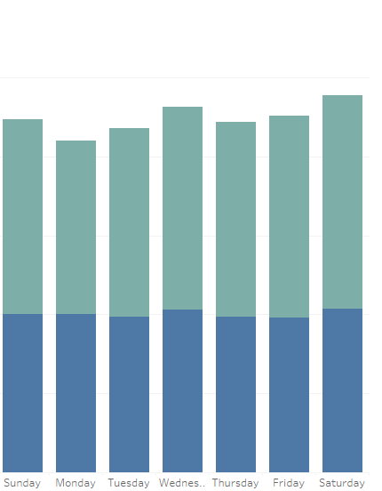
Avg Ride Length for Casual riders 20min
Avg Ride Length for Members 14 min

Slide 3
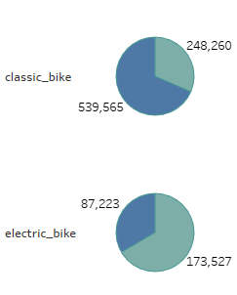
Members generally opted for the classic bike
Casuals preferred the electric bike

Slide 4
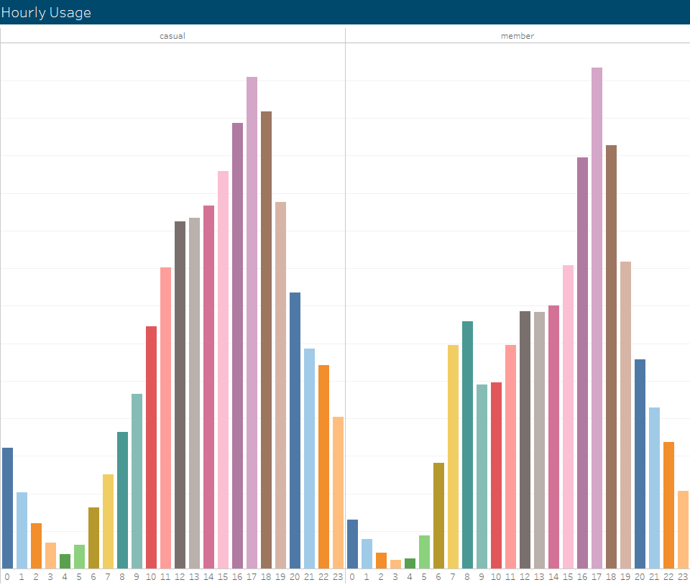
Peak ride start time for both members and casuals was at 5 PM the same time rush hour starts in Chicago

Slide 5
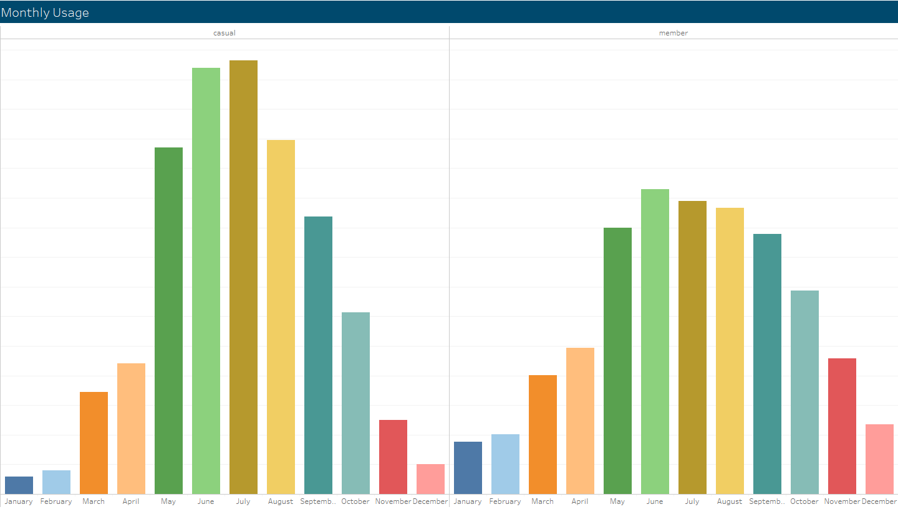
Peak usage happens in summer during May, June, July, and August

Slide 6
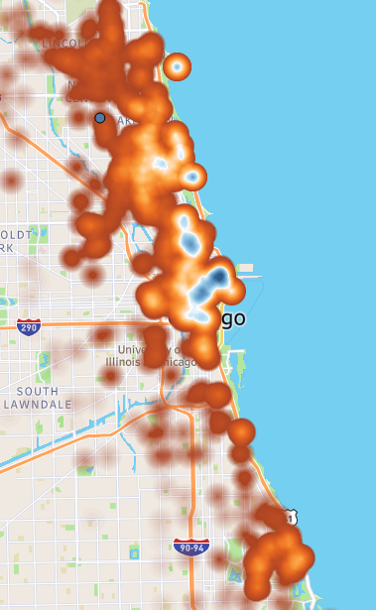
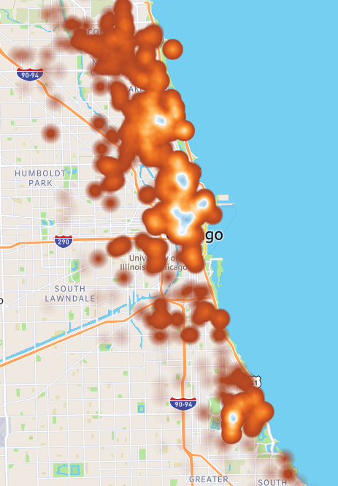
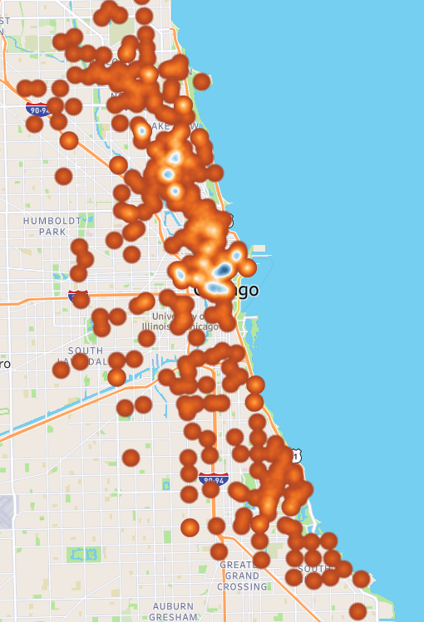
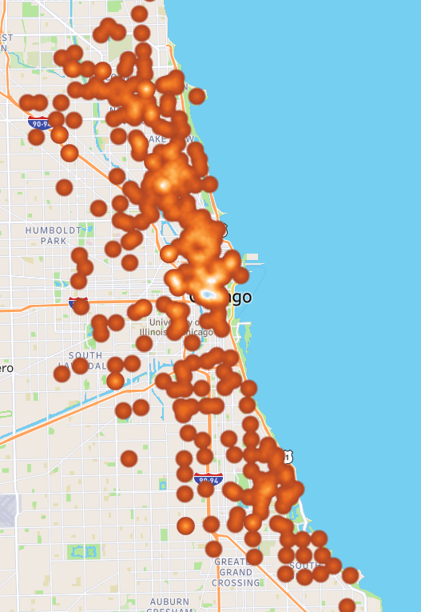
Using the map we can see that Casuals are more likely to start and end their ride in Downtown Chicago

Slide 7
How can the Marketing team apply this knowledge to create a new marketing strategy to convert casual riders into annual members?
- Run advertisements and promotions for memberships in the summer months and during rush hour at around 5 pm in May, June, July, and August with the incentive that casual riders can save more money for taking rides.
- Since casual users use bikes on average for 5 minutes longer I suggest increasing the membership ride duration if possible since casuals generally prefer electric bikes have a program in the membership category where electric bikes can be used for a maximum of 20 minutes per ride
- Targeting marketing efforts in areas where casual riders frequently start their trips, such as Streeter Dr & Grand Ave, DuSable Lake Shore Dr & Monroe St, and Millennium Park, could be an effective way to increase the number of casual riders who become members.

